Slide 1
Fine-tuned SSD Model for Face Detection
Group 12
Bingwen Dong, Jinyue Chen
Diancheng Kang, Ruiyang Dong

Slide 2
Outline
Introduction
Model Description
Dataset Collection and Processing
Training Process
Results and Evaluation
Challenges and Solutions

Slide 3
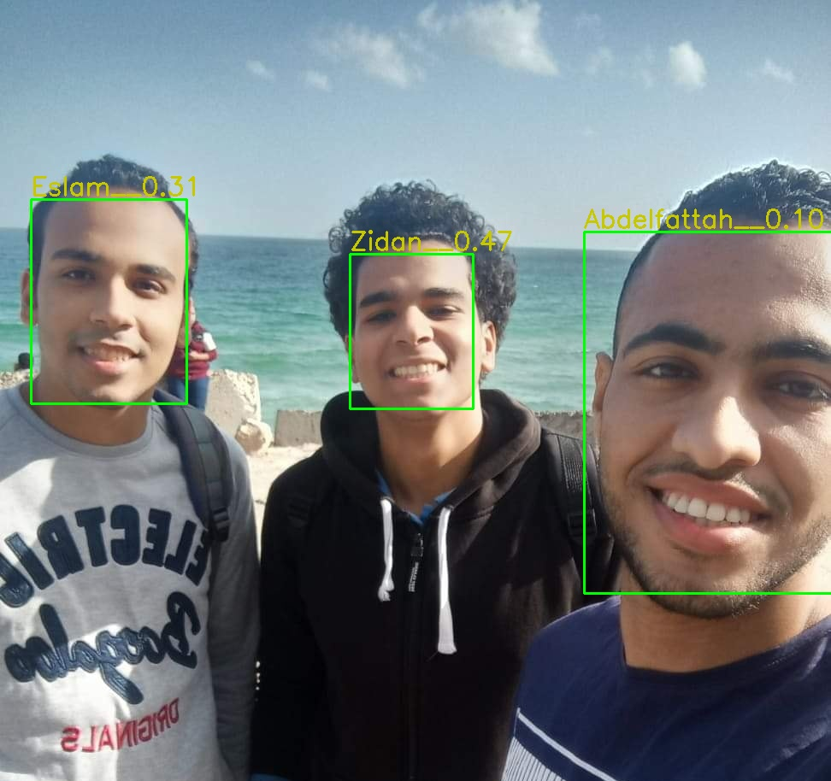
1
Introduction
Nowadays, many deep learning models achieve good performance in human face detection: FaceNet

Slide 4
1
Introduction
Our project focuses on running a deep learning model for human and cartoon face detection on the Jetson Nano development board
Limited computational power → Lightweight model
SSD (Single Shot Multibox Detector) for its balance between accuracy and efficiency

Slide 5
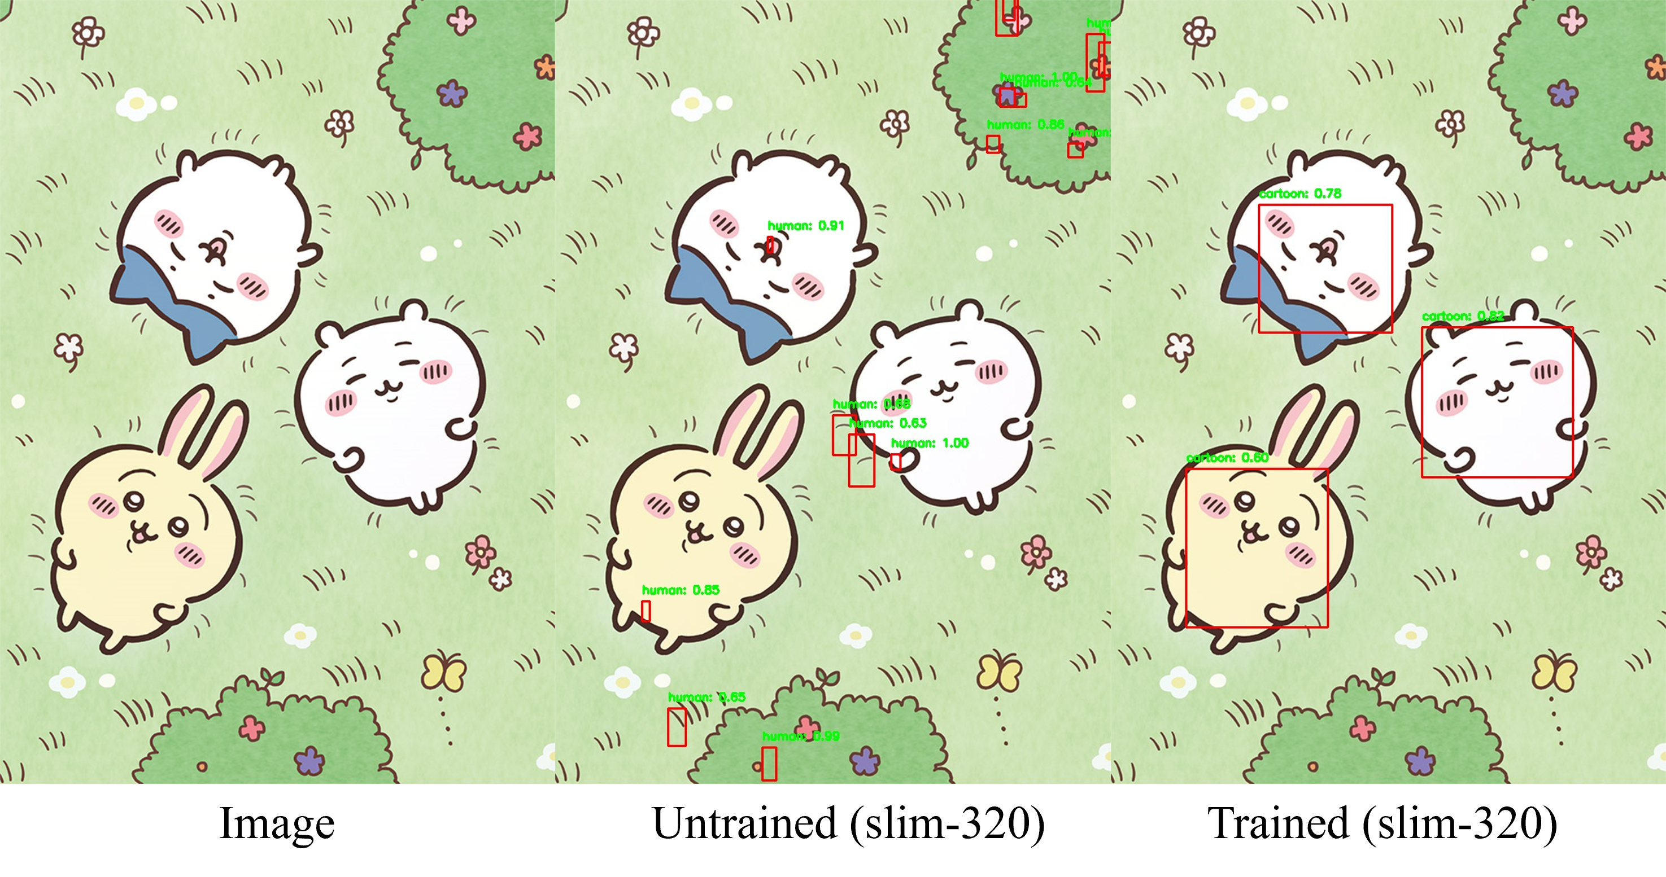
1
Introduction

Slide 6
Outline
Introduction
Model Description
Dataset Collection and Processing
Training Process
Results and Evaluation
Challenges and Solutions

Slide 7
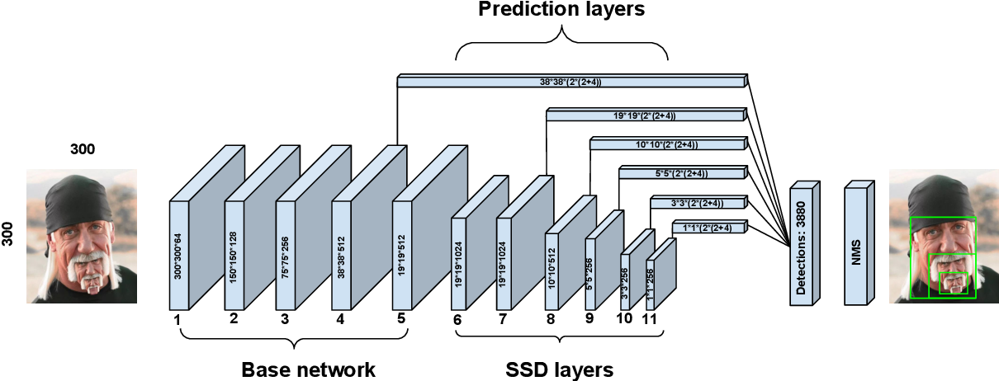
2
Network Architecture
Base Network: A convolutional neural network
Extra Feature Layers: Additional convolutional layers that capture multi-scale information
Default Boxes: Pre-defined bounding boxes at each scale to detect objects of varying sizes
Prediction Heads: Convolutional layers that predict class scores and box offsets for each default box

Slide 8
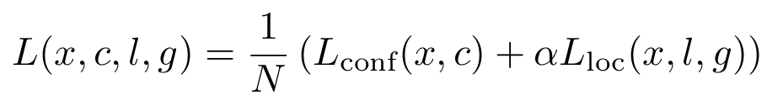
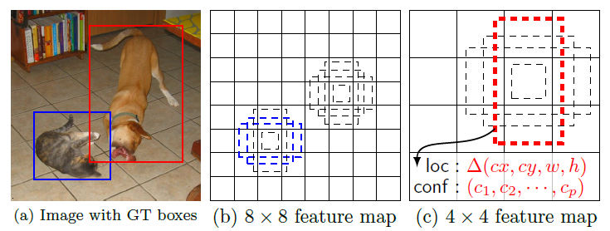
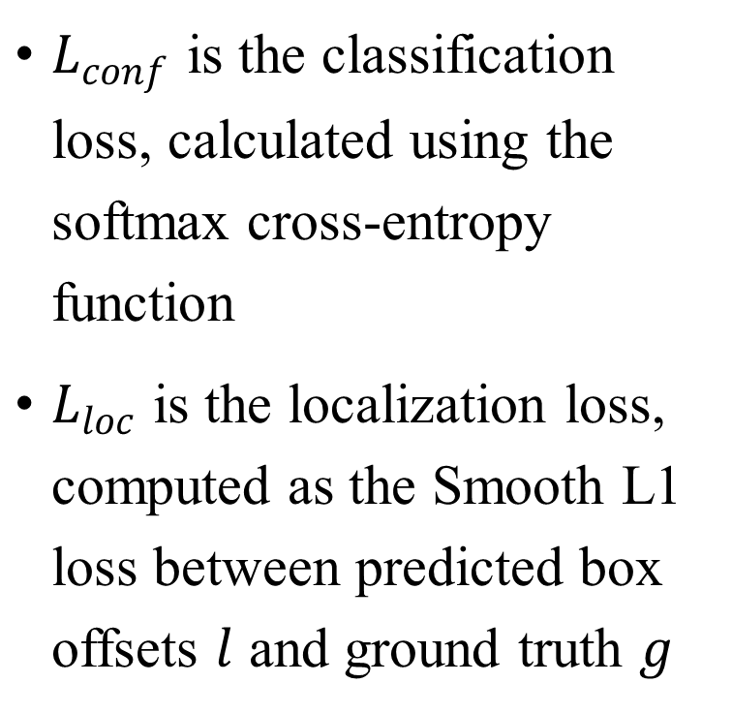
2
MultiBox Loss Function
$L_{conf}$ is the classification loss, calculated using the softmax cross-entropy function
$L_{loc}$ is the localization loss, computed as the Smooth L1 loss between predicted box offsets $l$ and ground truth $g$

Slide 9
2
Model Variants
Slim SSD: lightweight variant optimized for speed, reduce the number of convolutional filters and layers
RFB SSD: Incorporates Receptive Field Blocks to enhance feature extraction by capturing multi-scale and contextual information

Slide 10
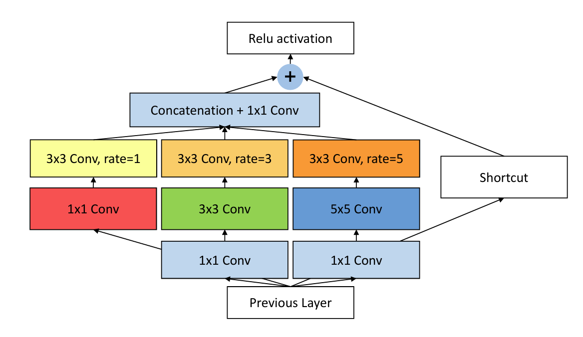
2
Receptive Field Blocks (RFB)
Using dilated convolutions to capture spatial context
Combining features from multiple scales with different receptive fields

Slide 11
Outline
Introduction
Model Description
Dataset Collection and Processing
Training Process
Results and Evaluation
Challenges and Solutions

Slide 12
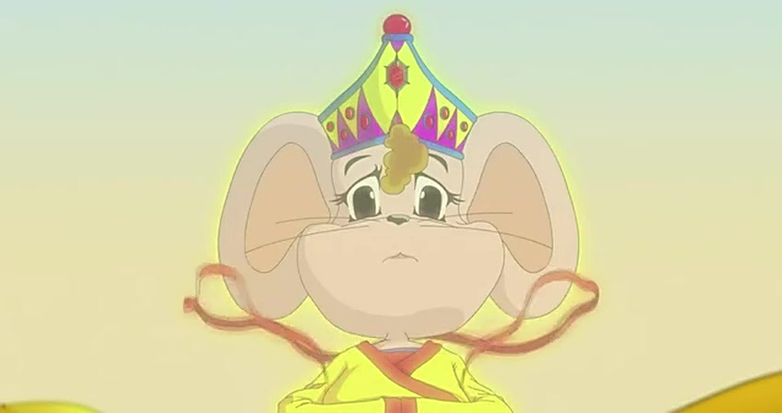
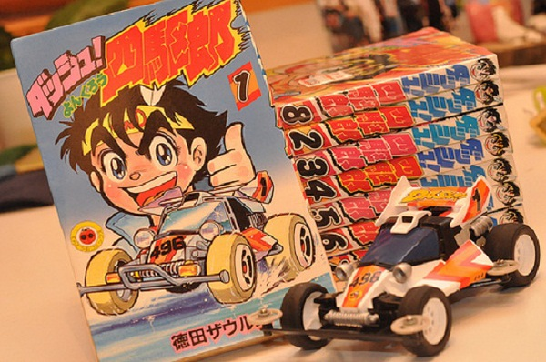

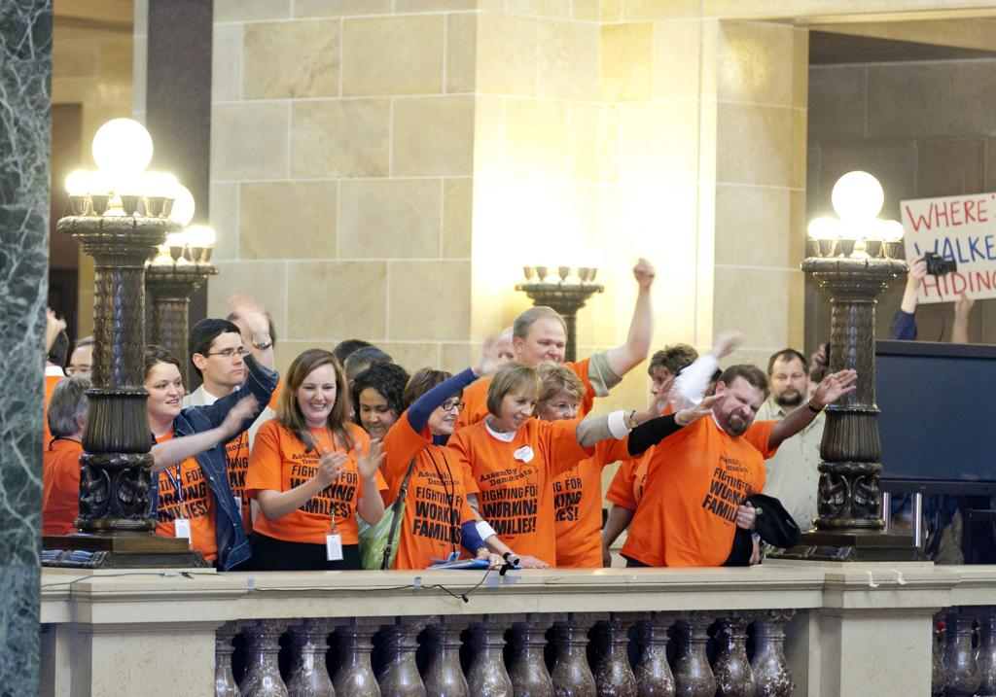


3
Dataset Collection
iCartoonFace Dataset: https://paperswithcode.com/dataset/icartoonface
Masked Face Detection Dataset: https://www.kaggle.com/datasets/sigmind/masked-face-detection-wider-dataset
Custom Cartoon Dataset: A dataset collected by crawling cartoon meme images (e.g. Joke Bear) from the internet

Slide 13
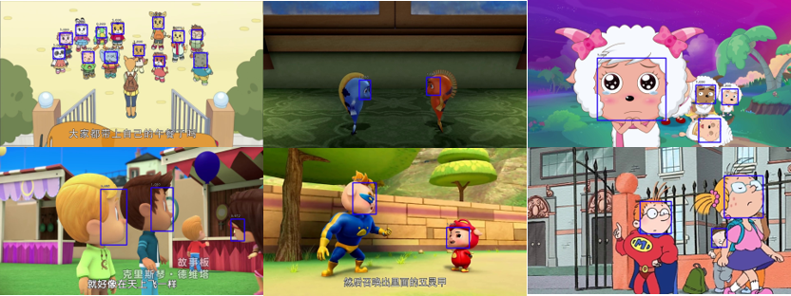
3
Data Processing
Preprocess to retain only bounding box coordinates and label
Discard Irrelevant metadata

Slide 14
Outline
Introduction
Model Description
Dataset Collection and Processing
Training Process
Results and Evaluation
Challenges and Solutions

Slide 15
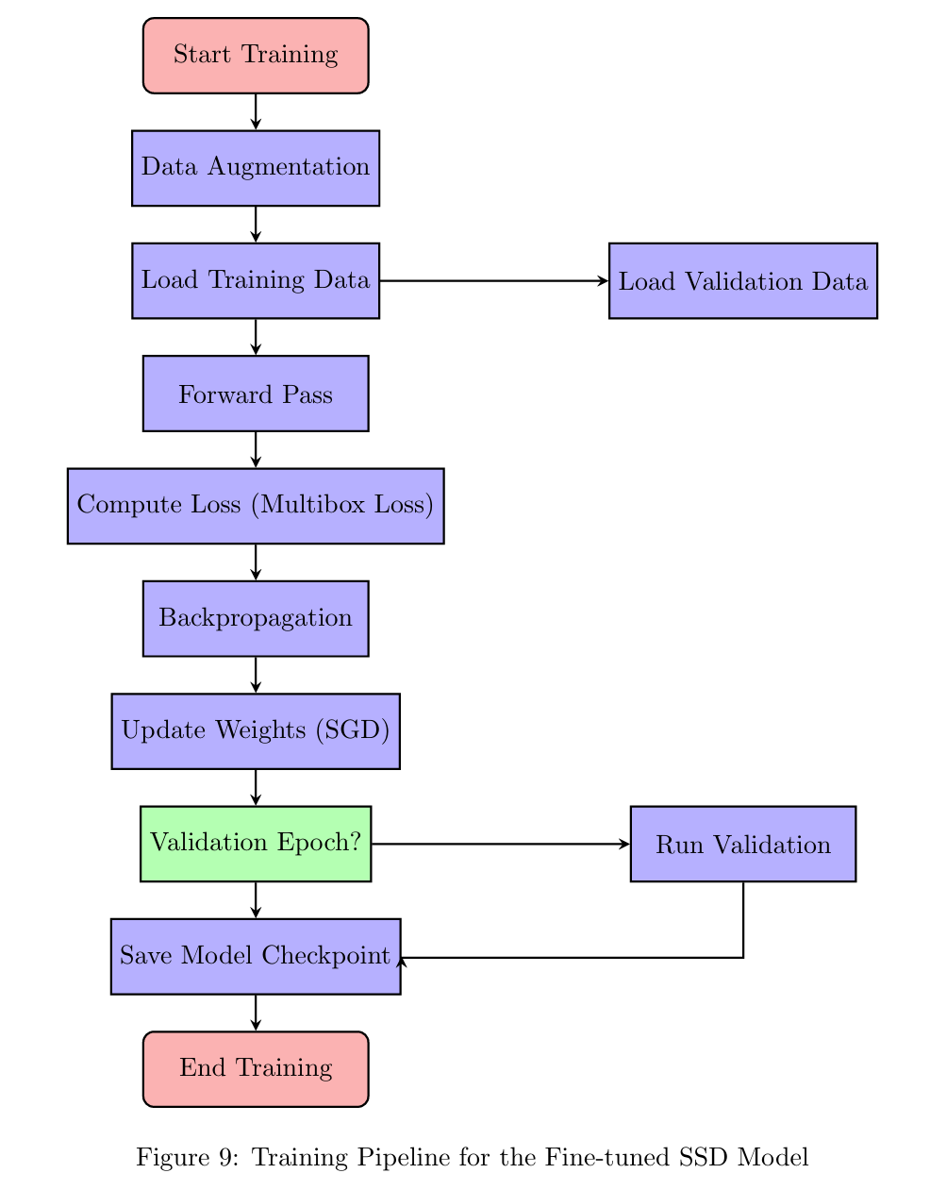
4
Training Pipeline

Slide 16
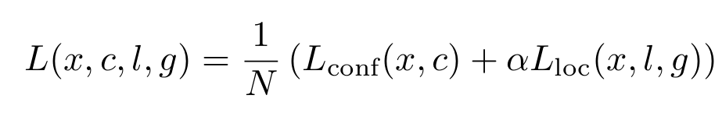
4
Training Configuration
Data Augmentation: Random cropping, flipping, color adjustment
SGD with momentum and weight decay
Loss Function:
Multi-step scheduler and cosine annealing scheduler
Model Checkpointing

Slide 17
Outline
Introduction
Model Description
Dataset Collection and Processing
Training Process
Results and Evaluation
Challenges and Solutions

Slide 18
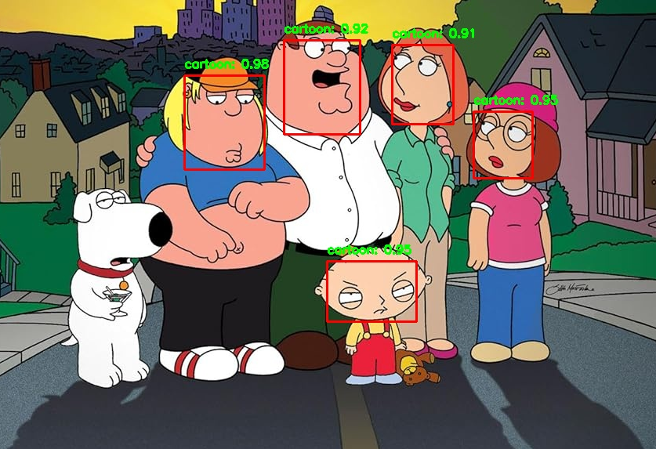
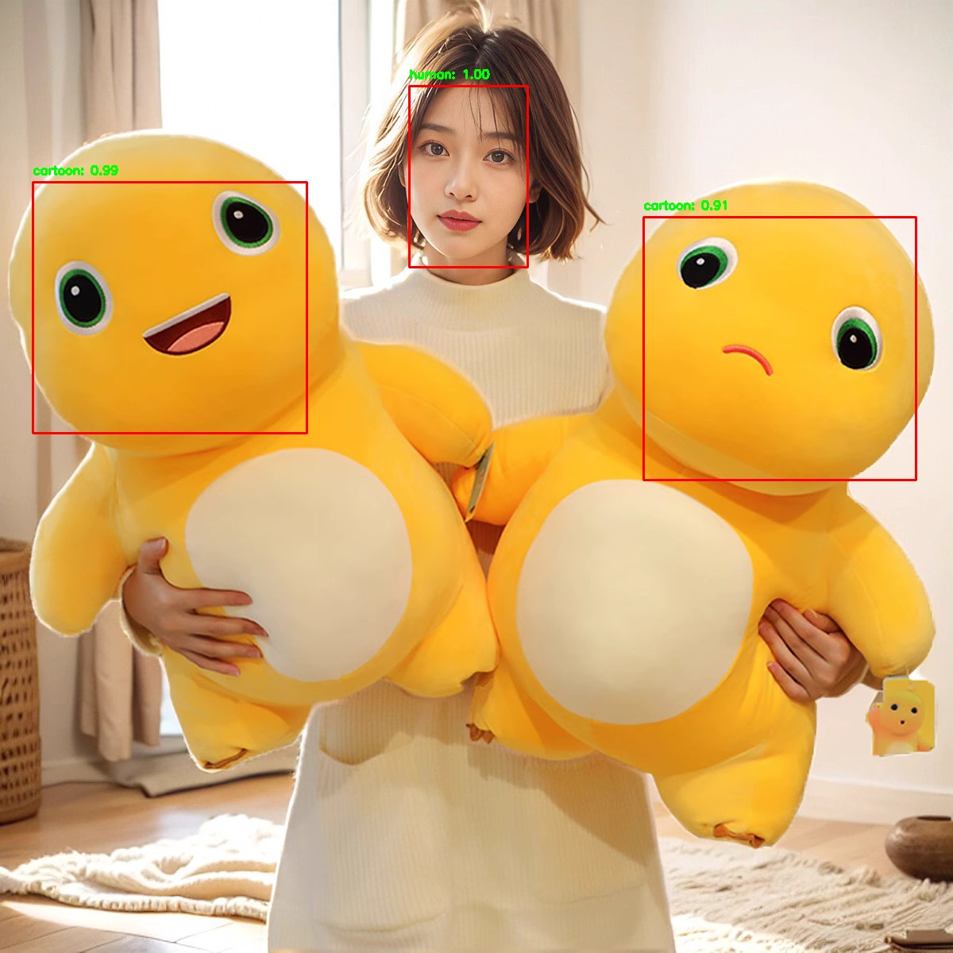
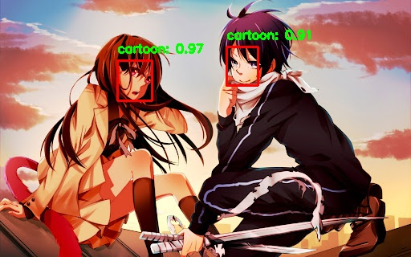
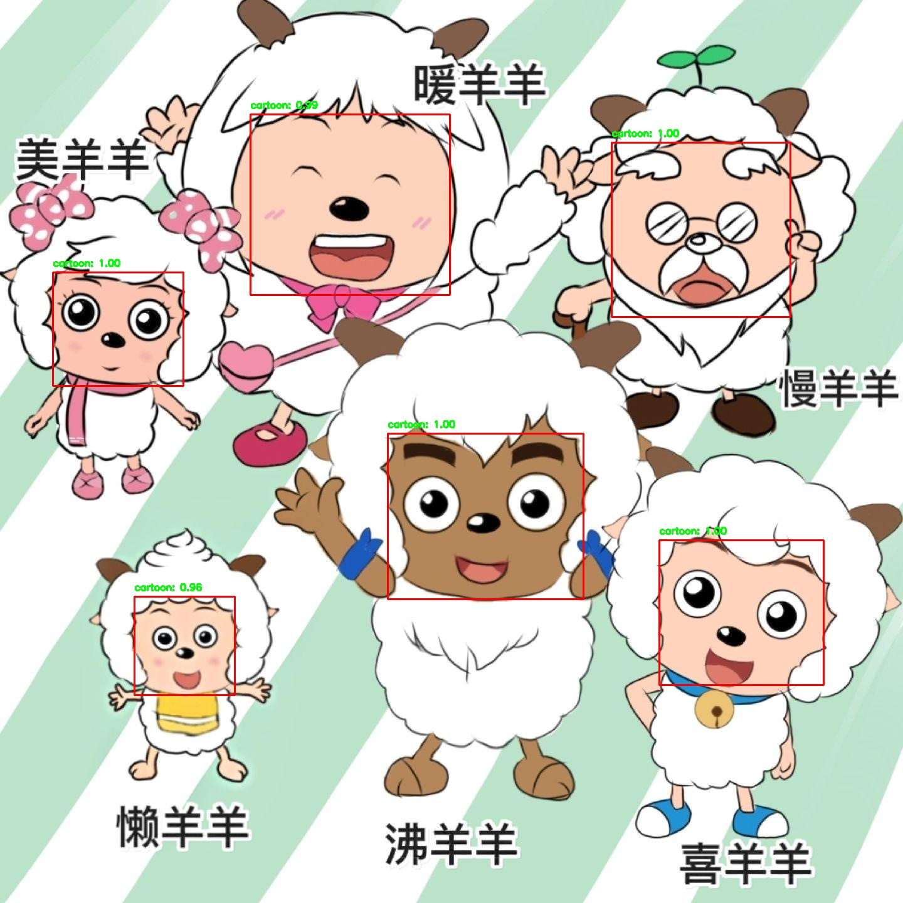
5
Examples

Slide 19
5
Examples

Slide 20
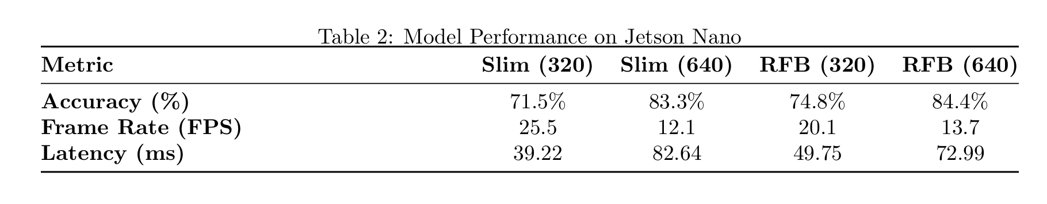
5
Model Performance

Slide 21
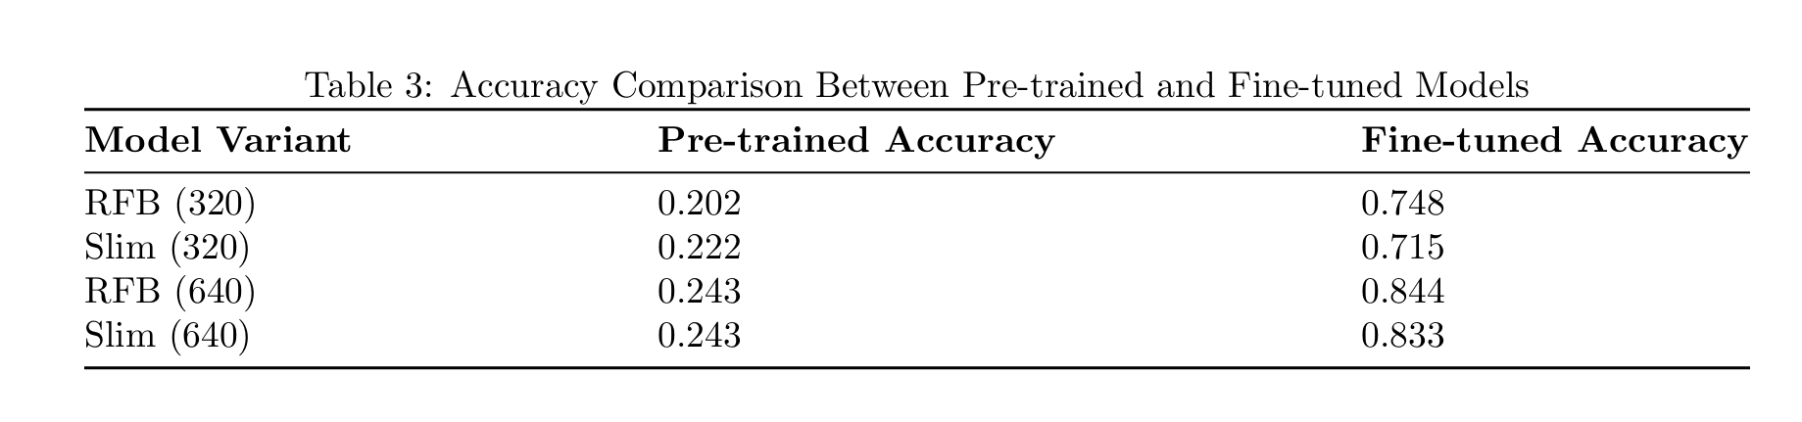
5
Pre-trained Models vs Fine-tuned Models Accuracy Comparison

Slide 22
Outline
Introduction
Model Description
Dataset Collection and Processing
Training Process
Results and Evaluation
Challenges and Solutions

Slide 23
6
Challenges and Solutions
Misclassification → Fine-tuning the model with cartoon images
Corrupted Dataset Images → Filtering out during preprocessing
Anti-Crawling Mechanism → Reducing request rate
Hardware-Specific Challenges → Experiment different configurations, Apply pruning techniques
Low Training Speed → Use RTX 4090 GPU

Slide 24
Thanks for watching!

